Slide 1
Amplification is the primary mode of gene-by-sex interaction in complex human traits
Carrie Zhu & Arbel Harpak

Slide 2

Motivation

Slide 3
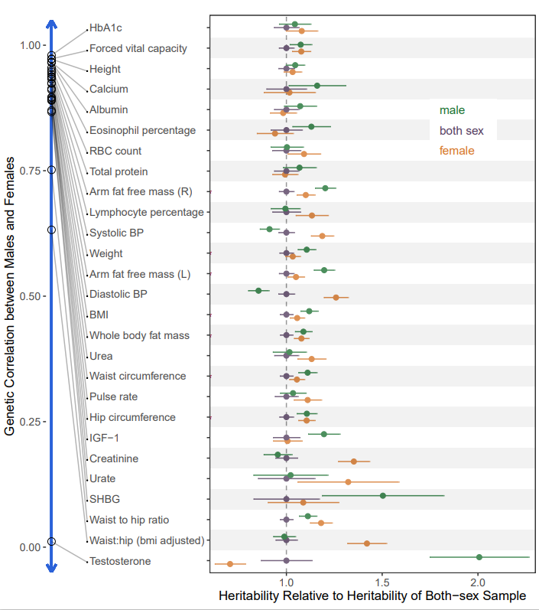
Previous Studies
Sex-specific SNPs
Genetic correlation
Heritability differences

Slide 4
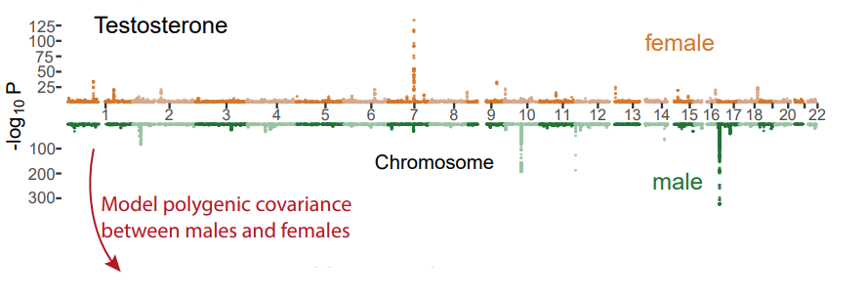
Infer Polygenic Covariance Structure
Method
Obtain sex-specific GWAS effect and standard error estimates
Input hypothesis covariance matrices into mash
Magnitude of amplification and correlation hypothesis
mash calculates posterior weights for each covariance matrices

Slide 5
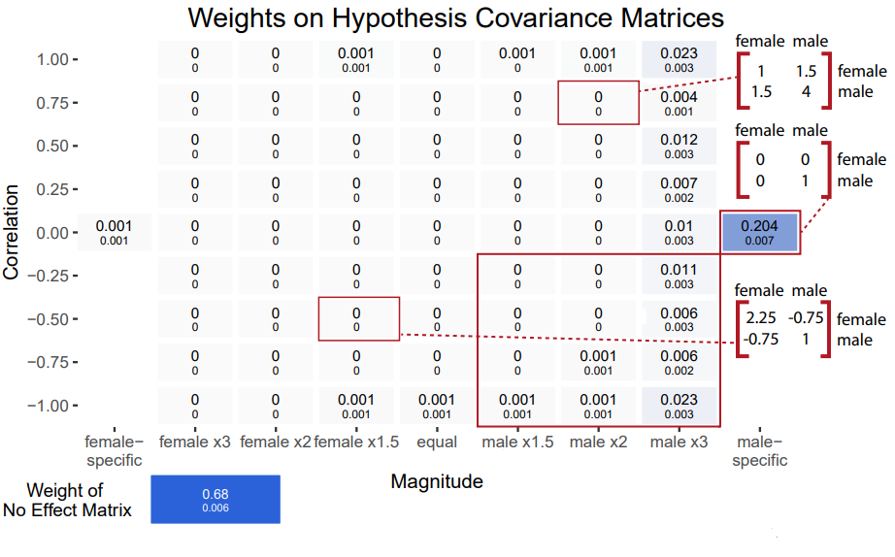

Slide 6
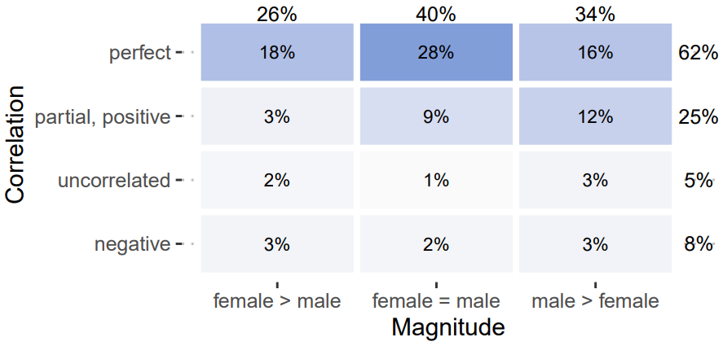
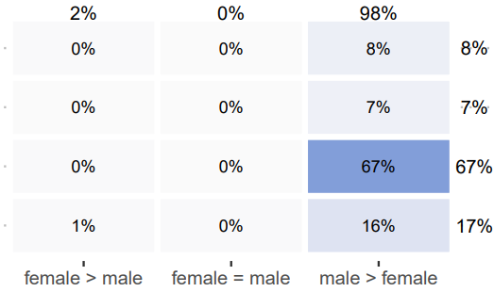
Covariance of Genetic Effects Compact Representation
Magnitude

Slide 7
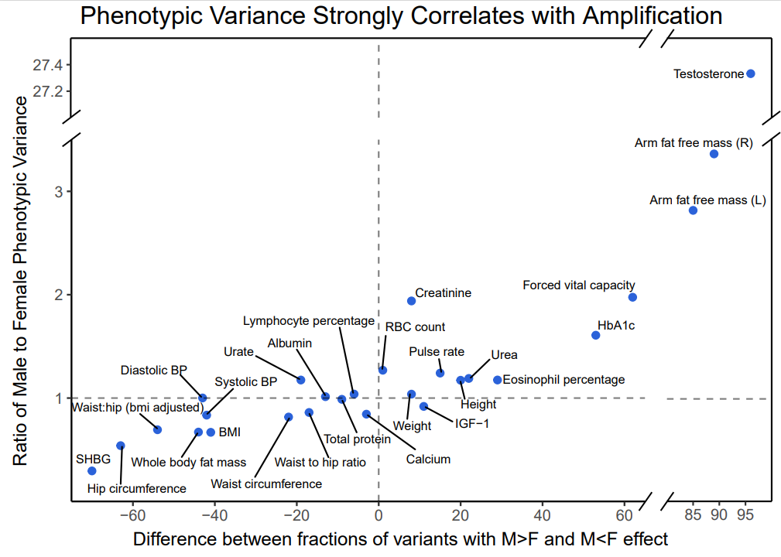

Slide 8
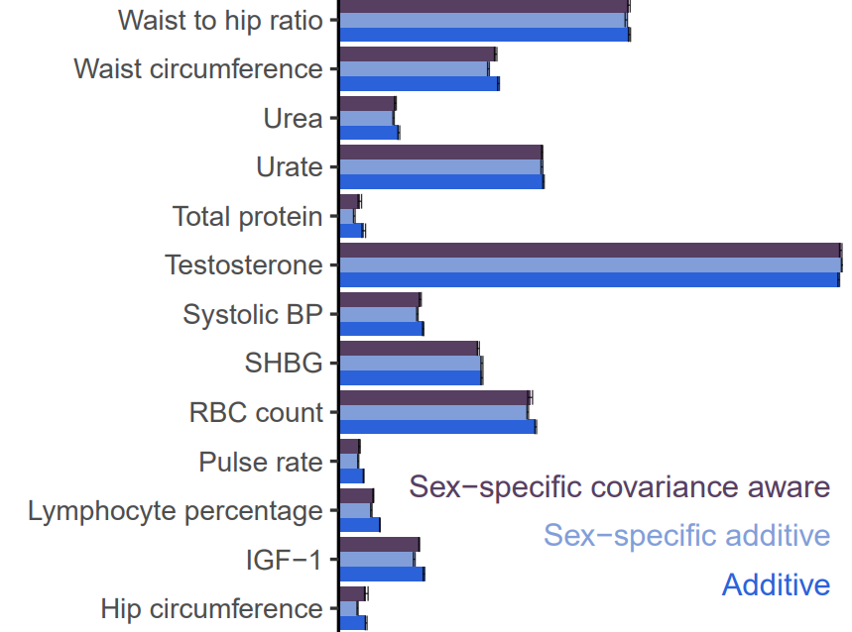
Comparing PGS
Method
Sample 25k out of ~150k male and females for test set
additive; sex-specific additive; and sex-specific covariance aware (mash)
Clump and PGS
Conduct over 5 folds
Combined model: use sex-specific scores to predict phenotype for corresponding sex
Sex-specific covariance aware model does not show significant improvement against the additive model

Slide 9
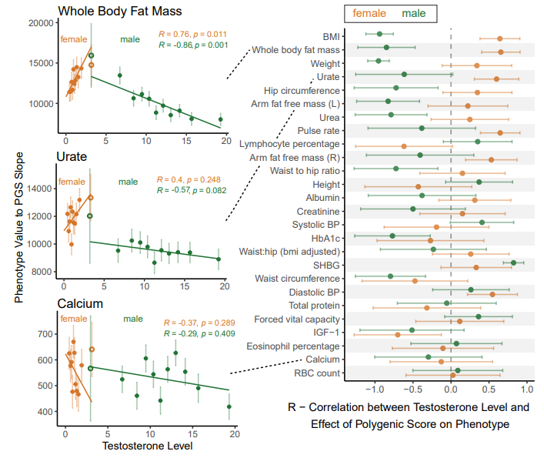
Testosterone as an underlier
Method: Regress phenotype value on PGS over multiple testosterone bins
Hollow circle signify overlapping bin
Equal testosterone level in males and females
See significant relationship with testosterone levels for many body mass related phenotypes
clear, but often contrasting relationship between males and females

Slide 10
Amplification of Genetic and Environmental Variance

Slide 11
Appendix A – mash Pipeline

Slide 12
Appendix B – PGS Pipeline

